Slide 1

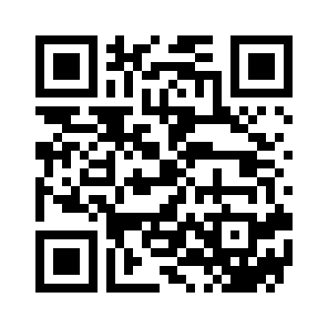
AI Leadership & Project Management
A Masterclass in Leading Successful AI Implementations Dr. Michael Borck

Slide 2
Today’s Journey
9:00-10:30am → Foundations & Frameworks
10:30-11:00 → Morning Tea
11:00-12:30pm → Stakeholder Management & Project Scoping
12:30-1:15pm → Lunch & Networking
1:15-2:30pm → Crisis Management in Action
2:30-3:00pm → Afternoon Tea
3:00-4:00pm → Strategic Decisions: Scale or Kill
4:00-4:30pm → Personal Action Planning & Framework Synthesis
Notes:
“This is a full, intense day but incredibly rewarding”
“You’ll leave with practical skills, not just notes”
“Every exercise builds on previous learning”
“Today isn’t about theory - it’s about practice”
“You’ll work hard, think critically, make difficult decisions”

Slide 3
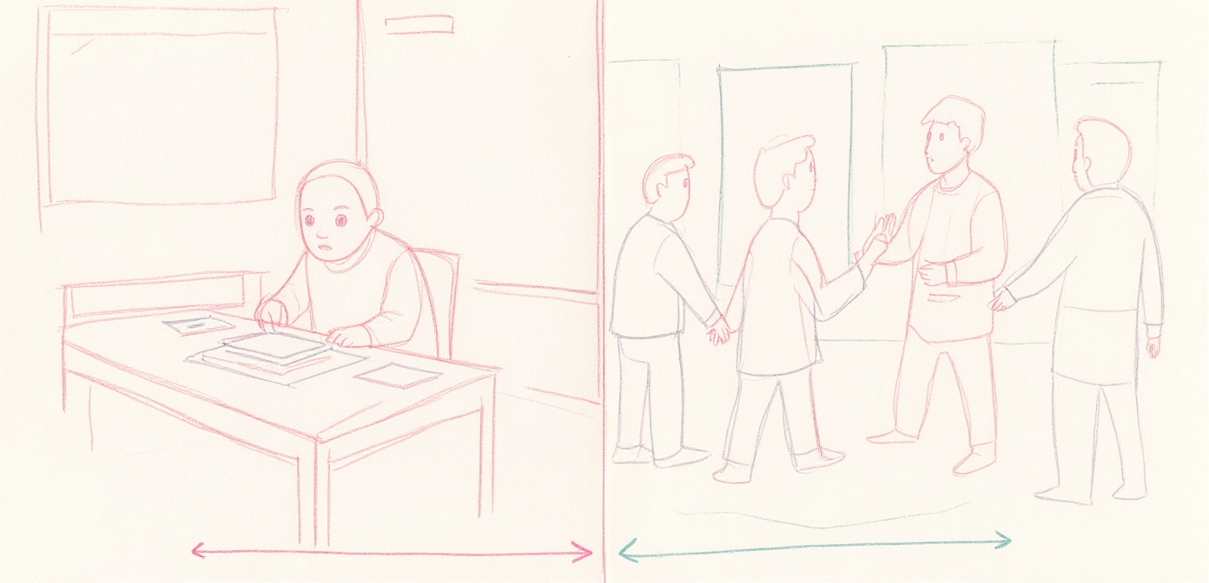
Learning Outcomes
You will: - Design • Manage • Navigate • Decide • Apply
AI Generated Image
Notes:
“By end of today: Design AI projects with appropriate scope and success metrics”
“Manage diverse stakeholders effectively in AI initiatives”
“Navigate ethical dilemmas and value-based decision making”
“Make informed scale/pivot/kill decisions for AI pilots”
“Apply crisis management frameworks to real AI project challenges”
“You’ll actually PRACTICE each of these today”
“You’ll leave with tools you can use Monday morning”
Lecture vs. Practice
Lecture → Decision-making Notes → Action Passive → Active Theory → Muscle Memory
“Today you’ll experience what AI project leadership FEELS like”
“The crises you’ll face are based on real projects”
“Some of you will feel uncomfortable - that’s where learning happens”

Slide 4
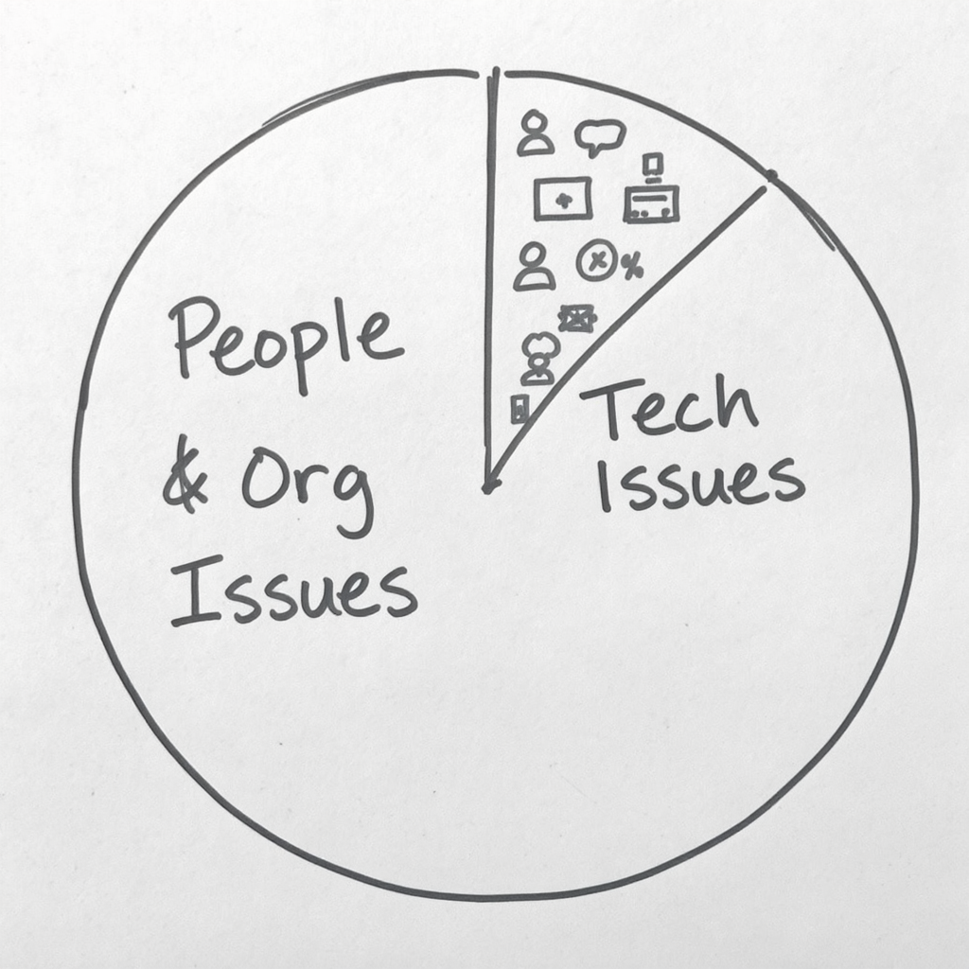
The Reality of AI Projects
AI Generated Image
Notes:
The Brutal Truth About AI Projects. 80% of AI projects fail to deliver value. Source: Gartner, 2023
“Let that sink in - 4 out of 5 AI projects fail”
“Technical Issues: 20% - Algorithm doesn’t work, Data quality problems, Infrastructure failures”
“People & Organizational Issues: 80% - Stakeholder resistance, Unclear objectives, Poor change management, Ethical oversights, Wrong metrics, Scope creep”
“Not because technology doesn’t work…”
“AI project leadership is NOT primarily about technology”
“It’s about people, politics, and change”
“That’s what we’re focusing on today”

Slide 5
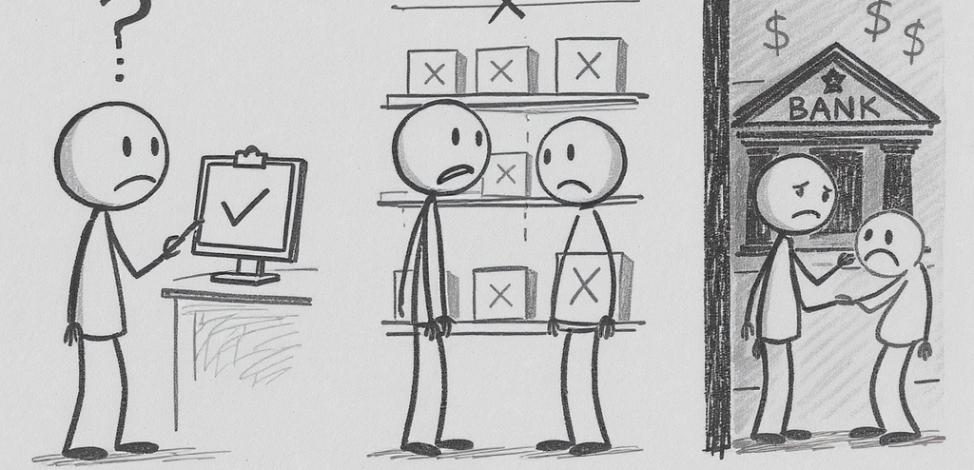
Real AI Project Failures
AI Generated Image
Notes:
🏥 Healthcare: Perfect algorithm, clinicians didn’t trust it
🏪 Retail: Worked great, destroyed jobs and PR
💰 Banking: Solved the problem, discriminated against people
“These are real projects (anonymized)”
“Healthcare: $5M investment, 2-year development, 95% accuracy in lab testing. Clinicians refused to use it. Forgot about user adoption.”
“Retail: Reduced stockouts by 40% (success!). Automated away jobs, union backlash, PR disaster. Didn’t manage people impact.”
“Banking: Improved processing speed by 70%. Discriminated against protected groups. Ethical oversight missing.”
“All had solid technology”
“All failed because of people and process issues”
“Today you’ll practice navigating exactly these challenges”

Slide 6
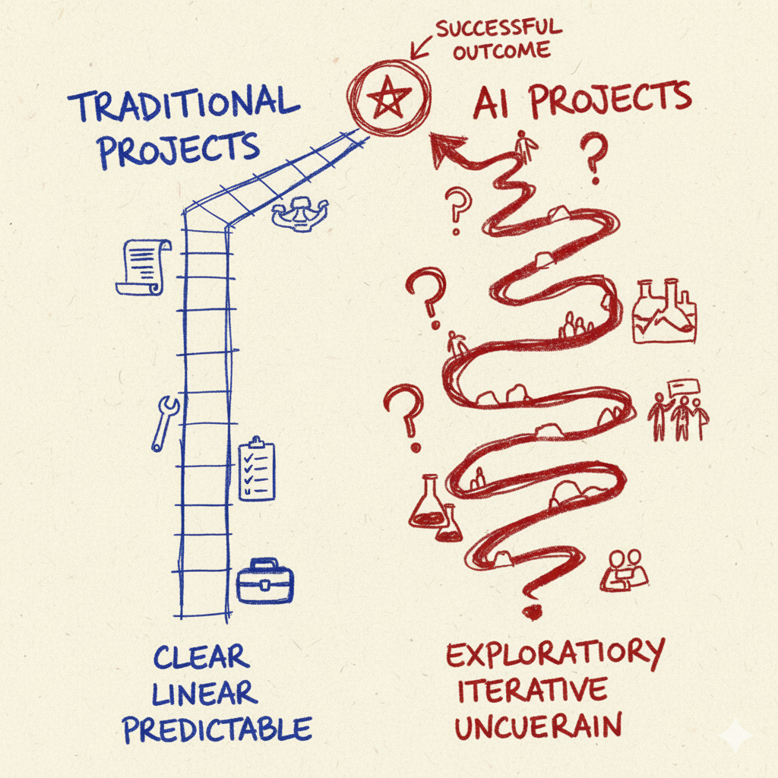
Traditional vs AI Projects
AI Generated Image
Notes:
Two Different Journeys
Traditional: Known → Linear → Clear → Predictable → Technical risk AI: Emergent → Iterative → Evolving → Experimental → Organizational risk
“Many of you have led successful traditional projects”
“AI projects require DIFFERENT skills - not better or worse, different”
“Traditional: Requirements known upfront, linear progression, success criteria clear, predictable timeline, technical risk primary, implementation focus, Gantt charts rule”
“AI: Requirements emerge through experimentation, iterative/hypothesis-driven, success criteria evolve, we’ll know more after pilot, organizational risk dominant, learning & adaptation focus, experiments rule”
“Today we focus on what’s unique about AI leadership”

Slide 7
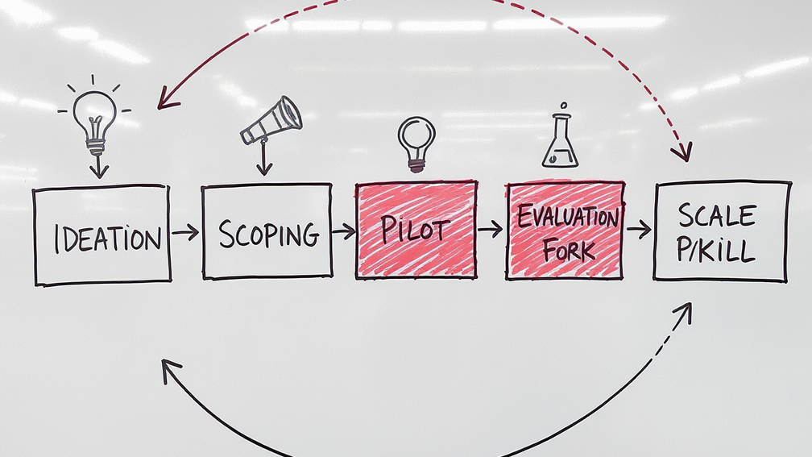
The AI Project Lifecycle
AI Generated Image
Notes:
“The journey: Ideation → Scoping → Pilot → Evaluation → Decision → Scale/Pivot/Kill (then loop back)”
“Most organizations rush through Scoping - that’s where you design for success”
“Most fail at Evaluation - they don’t measure the right things”
“Most struggle with Kill decision - sunk cost fallacy is powerful”
“Today you’ll practice the hardest parts: Scoping, Crisis Management, and Scale/Kill decisions”

Slide 8
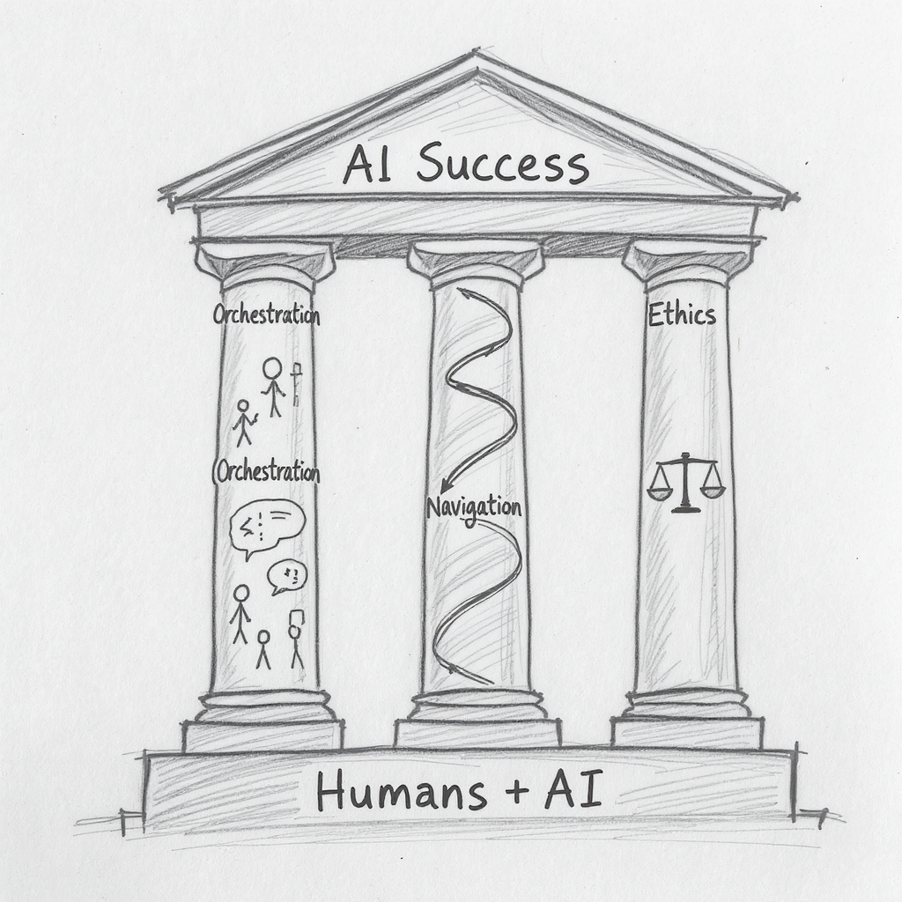
Core Framework
AI Generated Image
Notes:
Humans in the Loop
AI ≠ Replace Humans AI = Humans + Technology Working Together
Three Pillars: - Stakeholder Orchestration - Change Navigation - Ethical Leadership
“This is the core principle: AI projects aren’t about replacing humans with technology”
“They’re about designing new ways for humans and AI to work together”
“This framework will guide us through every exercise today”
“These three pillars aren’t fluffy - they’re mission-critical”
“These pillars will help you navigate every challenge you face”
“Stakeholder Orchestration: Align diverse interests and motivations”
“Change Navigation: Guide organizations through AI transformation”
“Ethical Leadership: Make values-based decisions under uncertainty”

Slide 9
Meet RetailFlow
Overview: 50 stores • $150M revenue • 2,000 people • Australia
Problem: Customer satisfaction 78% → 68%, 26-hour response times
Solution: AI chatbot pilot (2 weeks live)
Your Role: AI Project Manager
Notes:
“This is a realistic but fictional company”
“We’ll use RetailFlow for all exercises today”
“You are the AI Project Manager”
“The chatbot pilot launched 2 weeks ago”
“It’s the mix of physical retail and e-commerce that makes this complex”
“Customer satisfaction is dropping, response times are terrible, competition is moving faster”
“They’ve decided to try AI as the solution”
“You’re about to face the reality of AI project leadership…”

Slide 10
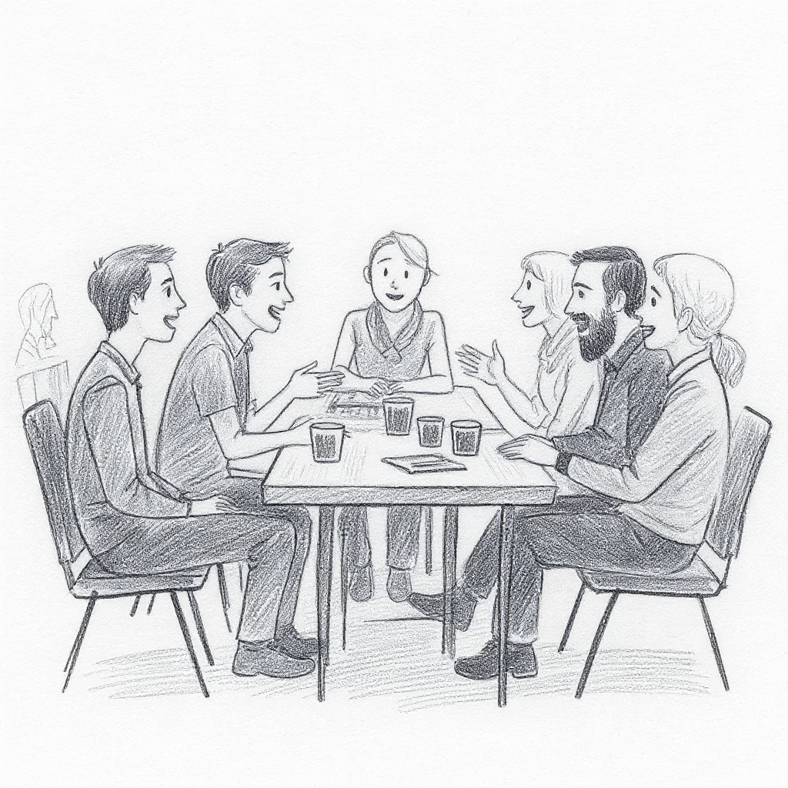
Exercise: Stakeholder Speed Dating
Objective: Experience AI project stakeholder perspectives firsthand
AI Generated Image
Notes:
What you’ll do:
Each person receives a role card (one of 6 stakeholders)
Read your role card carefully (3 minutes)
Have 5-minute conversations with different stakeholders
Stay in character - embrace their fears and motivations
Take notes in your workbook
Materials: Role cards will be distributed now
Distribute role cards (one per person, mixed across tables)
Give 3 minutes to read role cards
Explain: “You’ll rotate conversations every 5 minutes when I ring the bell”
“Stay in character - experience their perspective, not your own”
Set timer, ring bell every 5 minutes for rotations

Slide 11
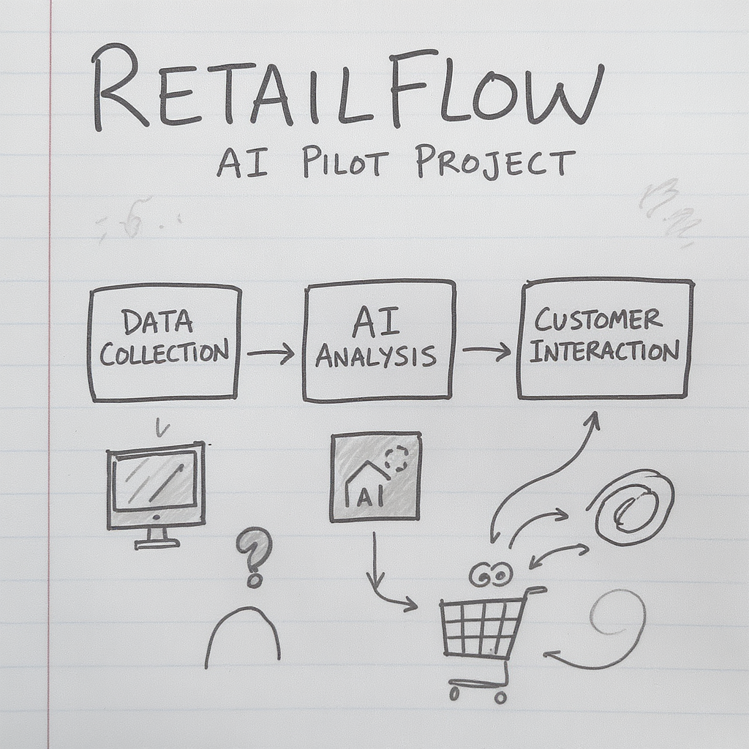
Exercise: Pilot Scoping Challenge
Objective: Design a well-scoped AI pilot for RetailFlow
AI Generated Image
Notes:
The Challenge: RetailFlow’s customer service is broken (26-hour response times, 68% satisfaction)
Your Task:
Review the RetailFlow case study in your packet
Complete the Pilot Scoping Worksheet as a group
Define: Scope, metrics, risks, budget, timeline
Make it “Goldilocks perfect” - not too big, not too small
Then… a surprise constraint will change everything
“All materials are in your participant packet”
“Turn to the Pilot Scoping section”
“You have 30 minutes to complete the worksheet”
“One person should be scribe, but everyone contributes”
Set 30-minute timer
After 20 minutes: Give 10-minute warning
After 30 minutes: Distribute ONE random constraint card per group
“You now have 10 minutes to adapt your plan based on this constraint”

Slide 12
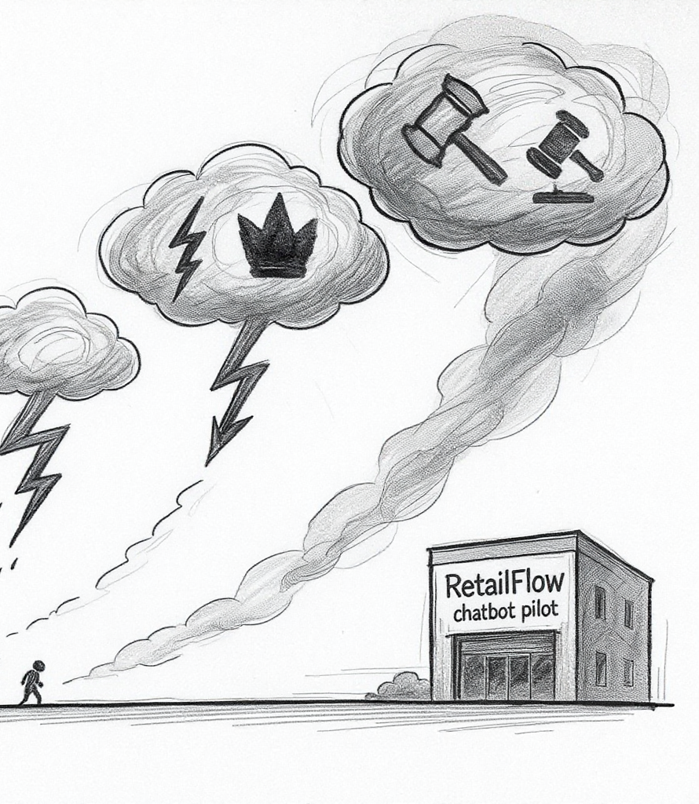
Exercise: Crisis Management Simulation
AI Generated Image
Notes:
“This is the centerpiece of the day”
“The Scenario: You’re 2 months into the RetailFlow chatbot pilot. Week 2 of live deployment.”
“You will face 4 crises in 75 minutes, each one different”
“Crisis 1: Data Quality Disaster (20 min) - Technical failure, AI giving wrong answers”
“Crisis 2: Staff Resistance (25 min) - People problem, team actively sabotaging”
“Crisis 3: Executive Pressure (25 min) - Leadership challenge, sponsor demands acceleration”
“Crisis 4: Ethical Dilemma (20 min) - Values decision, AI works but discriminates”
“Work through each crisis sequentially in your groups”
“You’ll experience what AI project crises FEEL like”
“Some involve role-plays with me - I’ll come to your table”
“Diagnose, decide, communicate - under time pressure”
“Let’s begin with Crisis 1 - Data Quality Disaster”

Slide 13
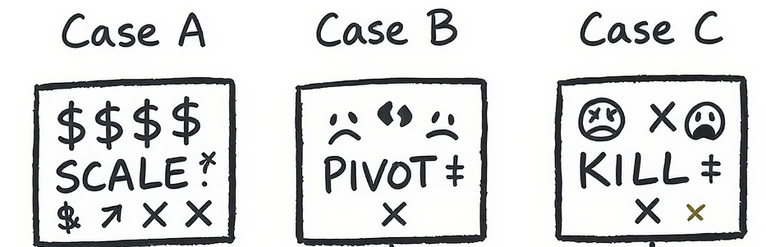
Exercise: Scale or Kill Decisions
AI Generated Image
Notes:
Three Cases
A: High ROI (but…) B: Destroyed morale C: Revenue up, satisfaction down
Your Call: SCALE • PIVOT • KILL
“Now you shift from tactical to strategic thinking”
“You’ll analyze three AI projects and make recommendations”
“Case A: Clear Success - inventory AI with 733% ROI (but is it straightforward?)”
“Case B: Clear Failure - scheduling AI that destroyed morale (but learn from it)”
“Case C: Ambiguous - pricing AI, good revenue but bad customer satisfaction (no perfect answer)”
“For each case, recommend: SCALE, PIVOT, or KILL”
“Defend your decision with evidence and reasoning”
“Use your Decision Framework reference sheet”
“You have 60 minutes total”

Slide 14
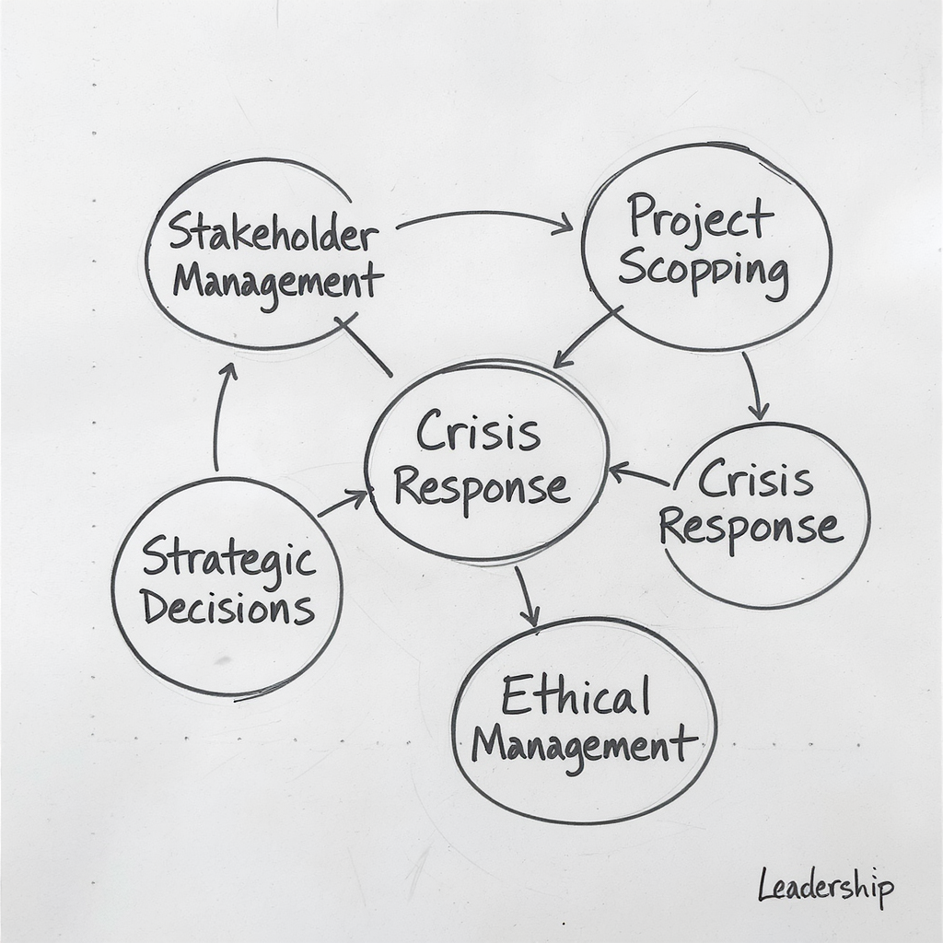
Frameworks
AI Generated Image
Notes:
“You’ve experienced all of these today”
“Stakeholder Management: Power-Interest Matrix, role perspective mapping, engagement strategies”
“Project Scoping: Goldilocks principle, success metric definition, risk mitigation planning”
“Crisis Response: Diagnose → Decide → Communicate → Document (technical vs. people vs. leadership vs. ethical)”
“Strategic Decisions: Scale/Pivot/Kill criteria, decision framework questions, risk assessment matrix”
“Change Management: Expect resistance, involve early, communicate constantly, change curve navigation”
“Ethical Leadership: Four key questions - Who benefits? What could go wrong? How do we know? When do we stop?”
“These aren’t just frameworks - they’re practical tools”
“Keep your reference sheet - use it on every AI project decision you face”
“The goal isn’t perfect decisions - it’s defensible decisions with clear reasoning”

Slide 15
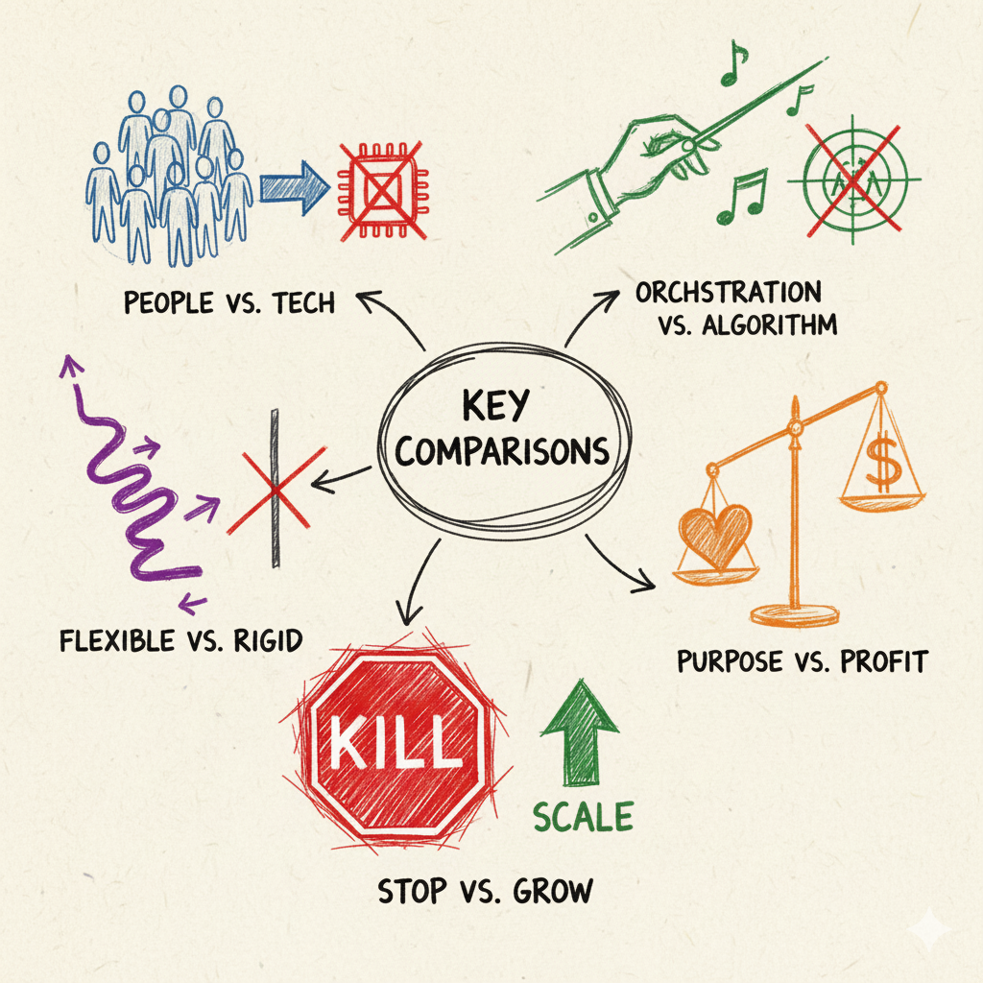
Core Insights
AI Generated Image
Notes:
People > Technology
Orchestration > Excellence
Flexibility > Plans
Ethics > Metrics
Kill > Scale (if needed)
“These aren’t just things you heard - they’re things you PRACTICED”
“AI projects fail from people issues, not technology (80% vs 20%)”
“Stakeholder orchestration is more critical than technical excellence”
“No plan survives first contact with reality - flexibility matters”
“Ethical decisions aren’t optional - they’re leadership responsibilities”
“Killing bad projects is success, not failure”
“You experienced stakeholder resistance firsthand”
“You made tough decisions under pressure”
“You navigated ethical dilemmas with no perfect answers”
“You have muscle memory now, not just theory”
“Data-driven decisions are good, values-driven decisions are essential”
“The cost of being wrong about scaling >> cost of being wrong about killing”
“When in doubt, run another small experiment rather than scaling prematurely”

Slide 16
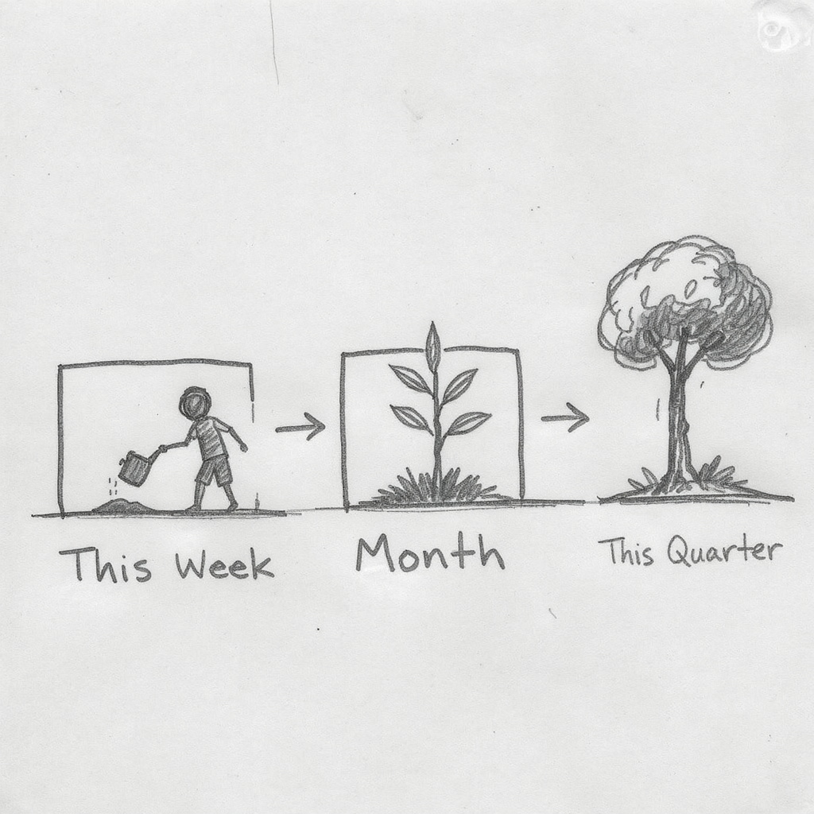
Your Action Plan
AI Generated Image
Notes:
This Week: What will you do?
This Month: What will you change?
This Quarter: What will transform?
“This is your personal reflection time - use the template in your packet”
“The goal isn’t to overwhelm you with a huge to-do list”
“Pick ONE thing to do differently this week - and define why and what success looks like”
“Then think about what you’ll change this month”
“Then what will be different this quarter”
“Build momentum with small wins”
“Use the frameworks - they’re tools, not rules”
“You have the capability now - you’ve practiced it”
Start small Measure what matters Involve early Document everything
“Four principles as you go back to work”
“Start small - apply one framework at a time”
“Measure what matters - not just what’s easy to measure”
“Involve early - don’t wait for buy-in, co-create it”
“Document decisions - use the frameworks to justify your choices”

Slide 17
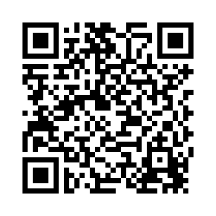
Please take 3-4 minutes to complete feedback
Michael Borck
michael.borck@curtin.edu.au
Notes:
“This isn’t the end of your learning journey”
“It’s the beginning of applying these capabilities”
“Business Innovation Masterclass is the strategic counterpart to this course”
“The frameworks will evolve as AI technology evolves”
“Stay curious, stay humble, stay learning”
Thank you for an intense, engaging day!
Apply what you learned. Lead with humans in the loop. Good luck with your AI projects!
Dr. Michael Borck michael.borck@curtin.edu.au
“Please take 3-4 minutes to complete feedback”
“Your honest input helps us improve these masterclasses”

